Slide 1
Bubble Sort
By
Manoj Yekolla

Slide 2
Important points
Bubble sort is a simplest sorting alogirthm.
Bubble sort that works by repeatedly swapping the adjacent elements.
it is compared and the elements are swapped if they are not in order.
This process is repeated as many times as necessary, until the array is sorted.

Slide 3
Code
using System;
using System.Collections.Generic;
using System.Linq;
using System.Text;
using System.Threading.Tasks;
namespace Bubblesort
{ //***********************\\
//Author:Manoj Yekolla
//Purpose:using Arrays bubble sort program
//************************\\
internal class Program
{
static void Main(string[] args)
{
//Array Initialization
int[] data = new int[] { 23 ,75,59,44,12,81 };
int manoj;

Slide 4
Code
//logic
for(int i = 0; i < data.Length-2;i++)
{
for(int j=0;j<=data.Length-2;j++)
{
if (data[j] > data[j + 1])
{
manoj = data[j + 1];
data[j+1]=data[j];
data[j] = manoj;
}
} }
//Ouput
foreach(var d in data)
Console.WriteLine(d);
Console.ReadLine();
} } }

Slide 5
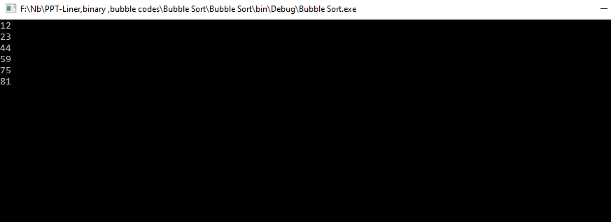
Output
Before Swapping - 23 ,75,59,44,12,81
After Swapping ->

Slide 6
Thank You

